Slide 1
An Analysis of a Bounded Resource Search puzzle
Gopal Anantharaman,
KnotTheory.ai Inc.

Slide 2

History
First posed in Foundation Of Computer Science - FOCS 1980
Algorithms & Theory of Computation book has an algorithm( non-optimal)
Several variations were studied.
My paper, published in Arxiv.org (May 2004 ) – First paper to study the general variant solution using Dynamic Programming.
https://arxiv.org/abs/cs/0405110
Mathematics Magazine – ‘The Egg-Drop Numbers’ – Vol. 77. No . 5 (Dec., 2004), pp. 368-372. possible independent study with rigorous formal proof.
Several sites with solution – Applicability? Not realized, as much!

Slide 3


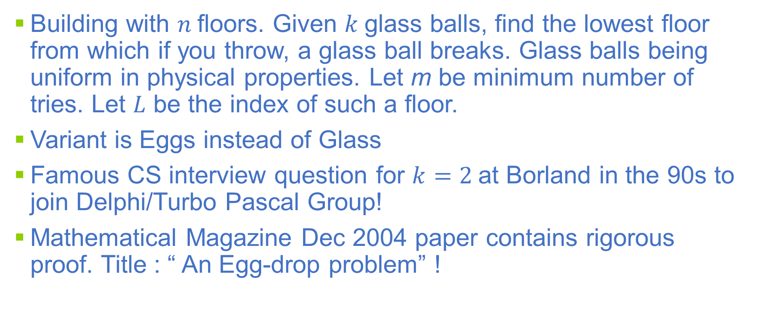
TAA SA deceivingly simple Puzzle
Yeah! The real puzzle is to Optimize Definitions first, before running Theorem mills…

Slide 4

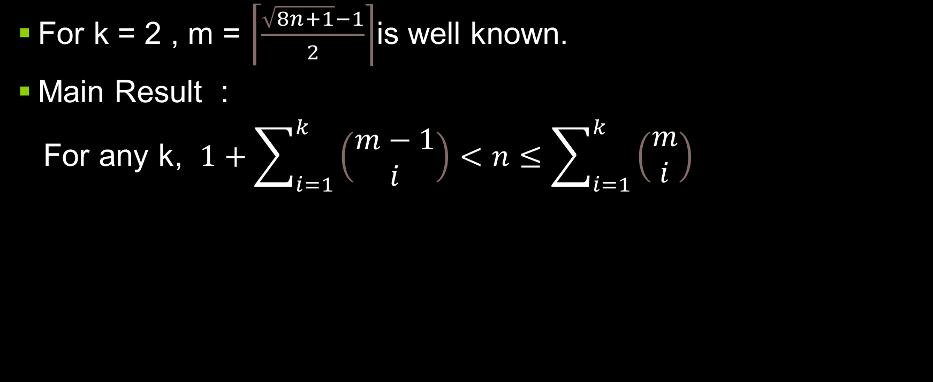
Main Result
Psst : is it Prime? yes Linear…Centauri Prime :-)

Slide 5
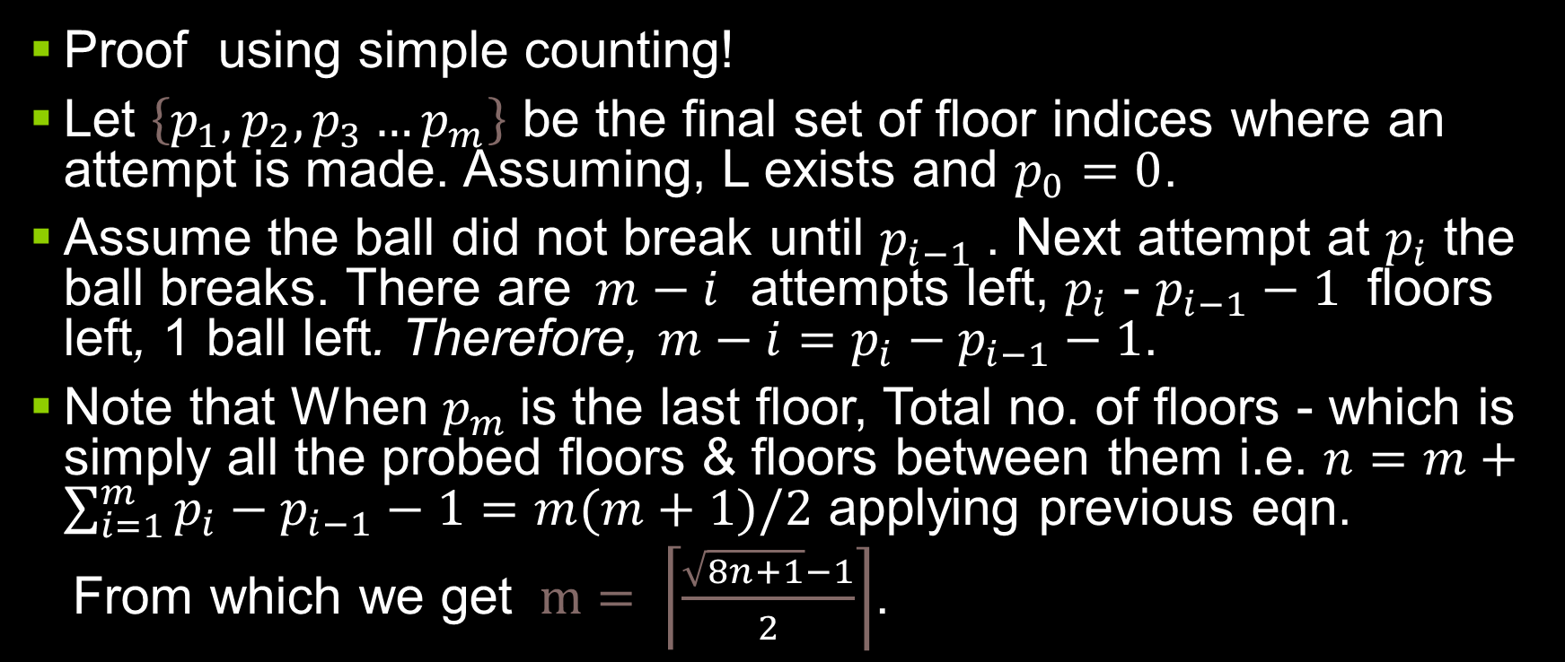
Proof for k =2
Even simpler proof! Run your incomplete paper as Prompt for ChatGPT LLM!

Slide 6

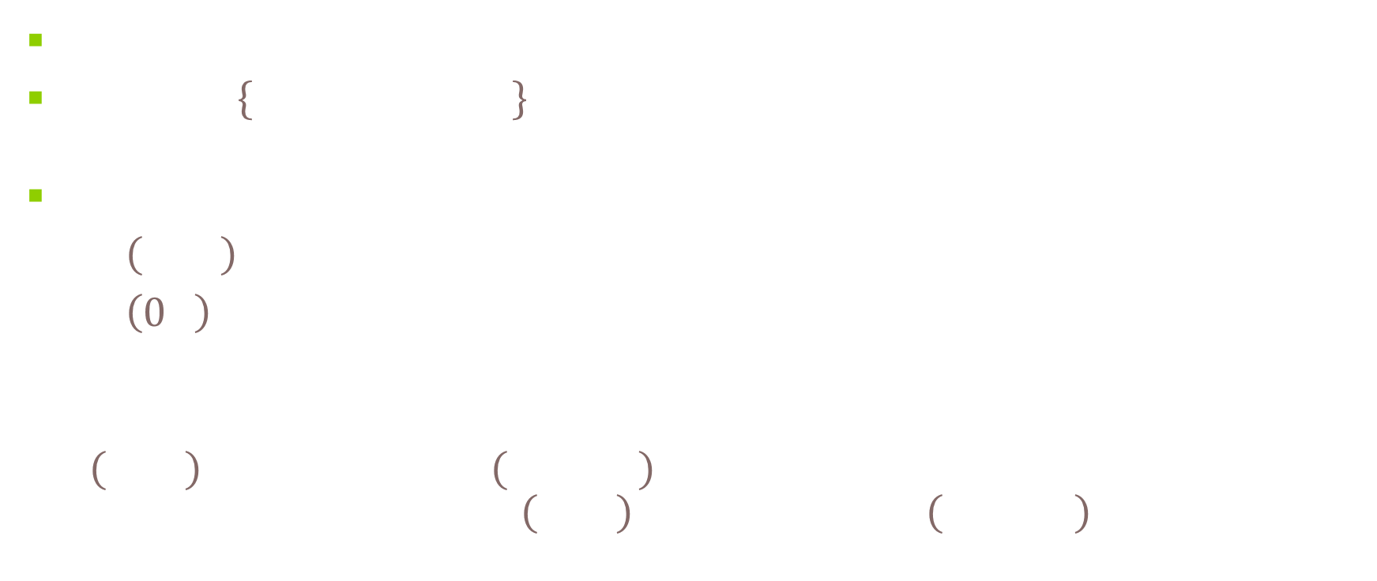
OOPS! ChatGPT completed my paper! I Swear!

Slide 7

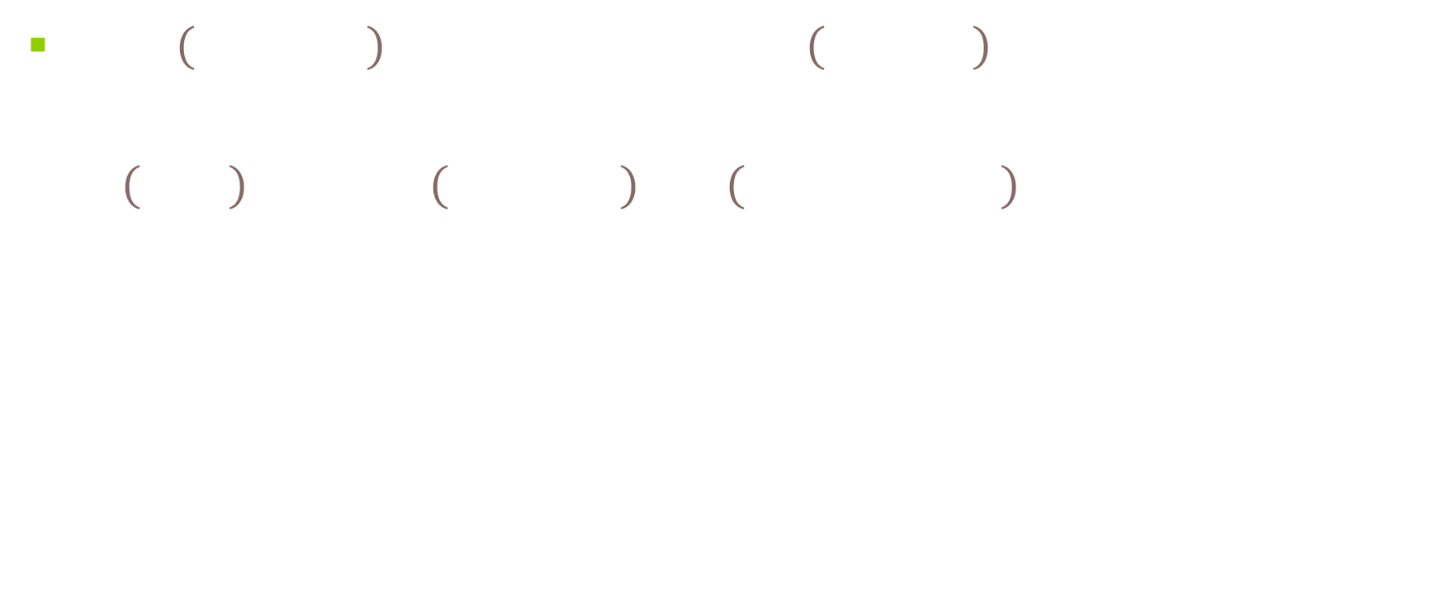
It’s close alright!...ChaptGPT completes my paper! Hmmmm…What Exactly is my Math, Then?

Slide 8

So, for k=2
Psst : Or Wolfram Alpha solve your polynomial

Slide 9
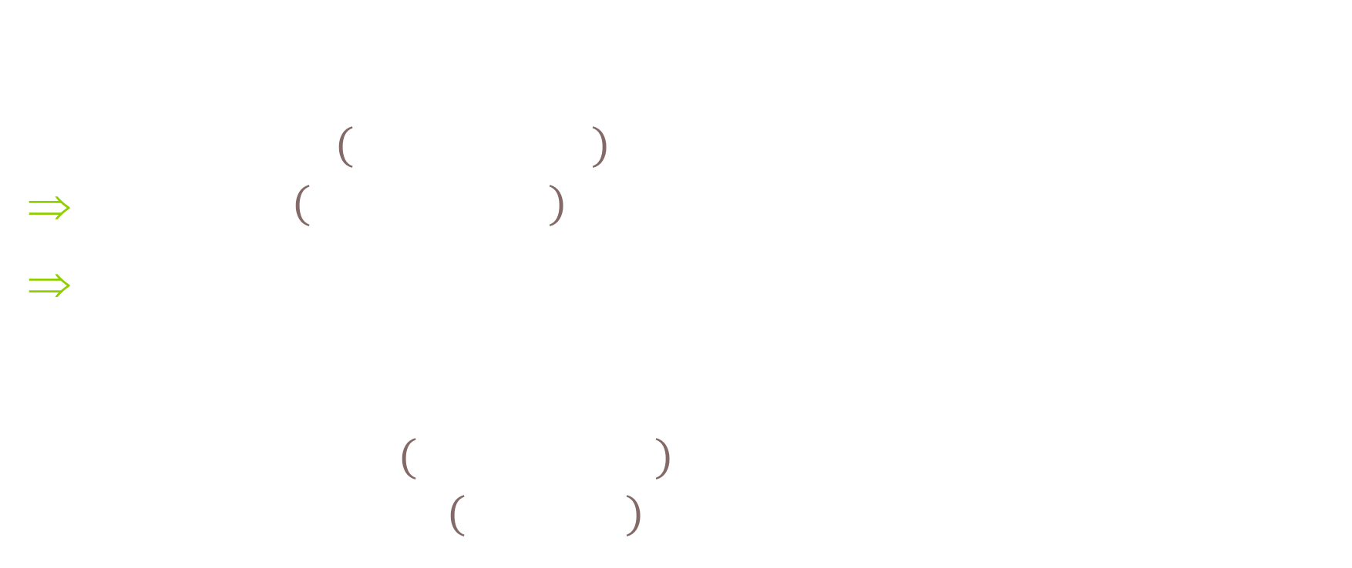
So, which floors to try?
Floor has a ceiling? May be there is no ceiling, or only Ceilings. Open , Closed ,Spaces.. sets…Whatever! Topological matters!

Slide 10
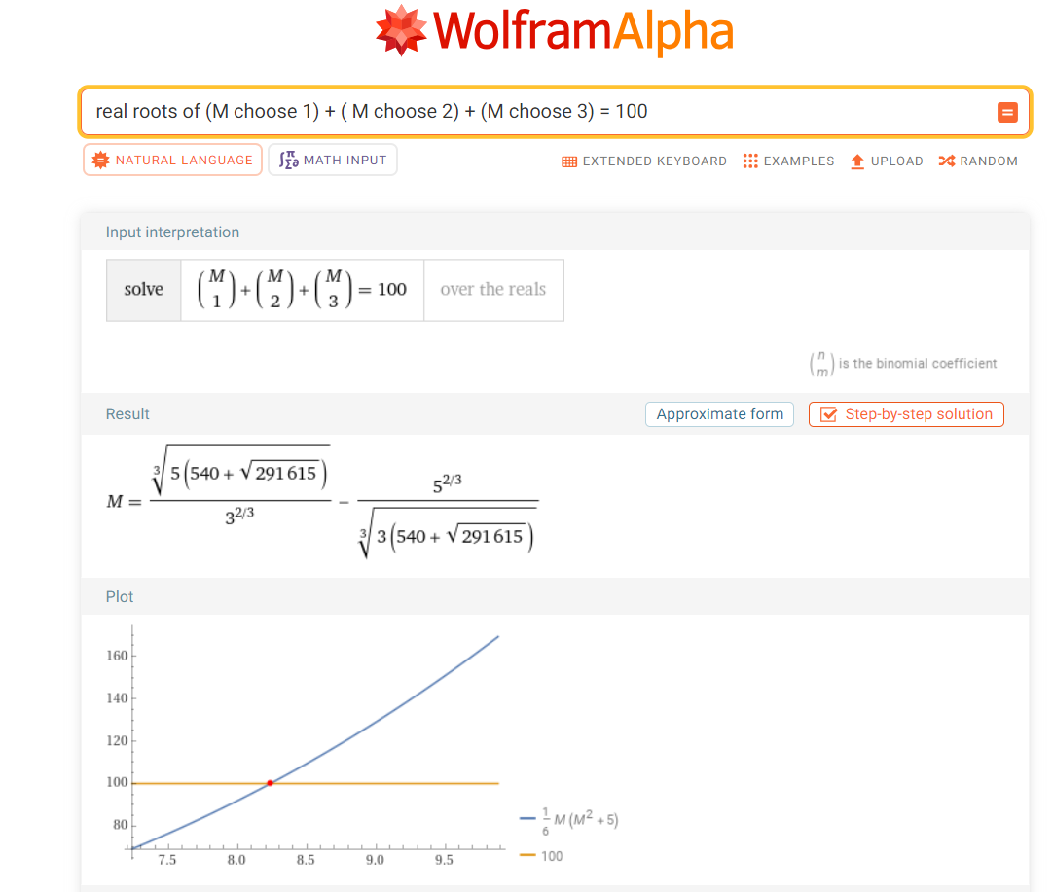
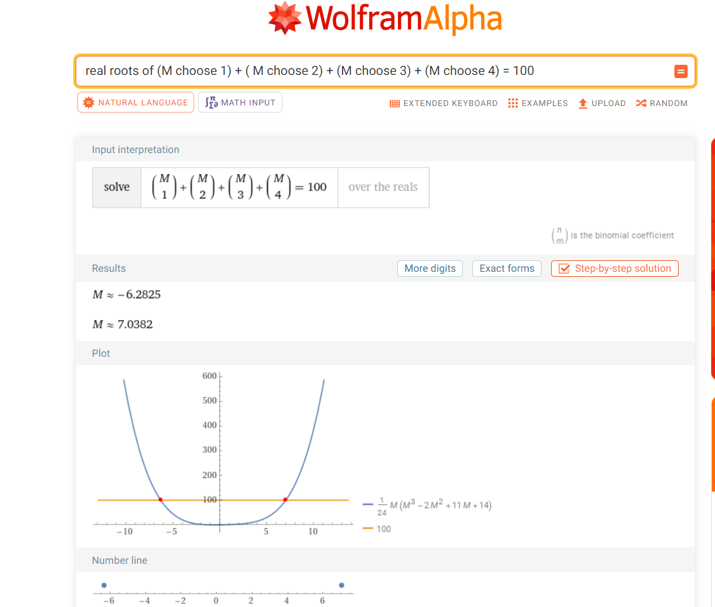
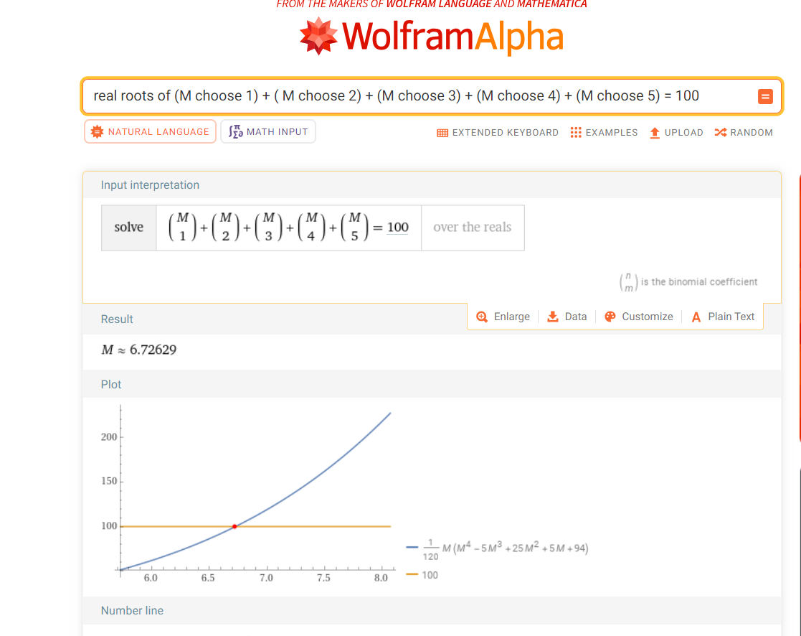
Examples for k= 3, 4, 5
Psst: Ahem!, I…However have a bunch of eggs & NaNs ☺

Slide 11

Quick look at the Polynomial-in-hand
Oh! I’ll throw one & Who wants to catch it from the Gal( group)?

Slide 12

Variations and Extensions
Catcher in the…, name thy floor!

Slide 13
Applications, A lot!
Here is Four more besides Network Loading…
Real Blackhole Event Horizon advance measure…
Data stream with long sequence of 0s starting ‘somewhere’ and 0s after.
Malicious ‘Node’, eating Web Crawlers – called Blackholes, in Byzantine Networks
Minima search in Convex models
One egg better be caught! That will be thrown from a real Blackhole ☺

Slide 14
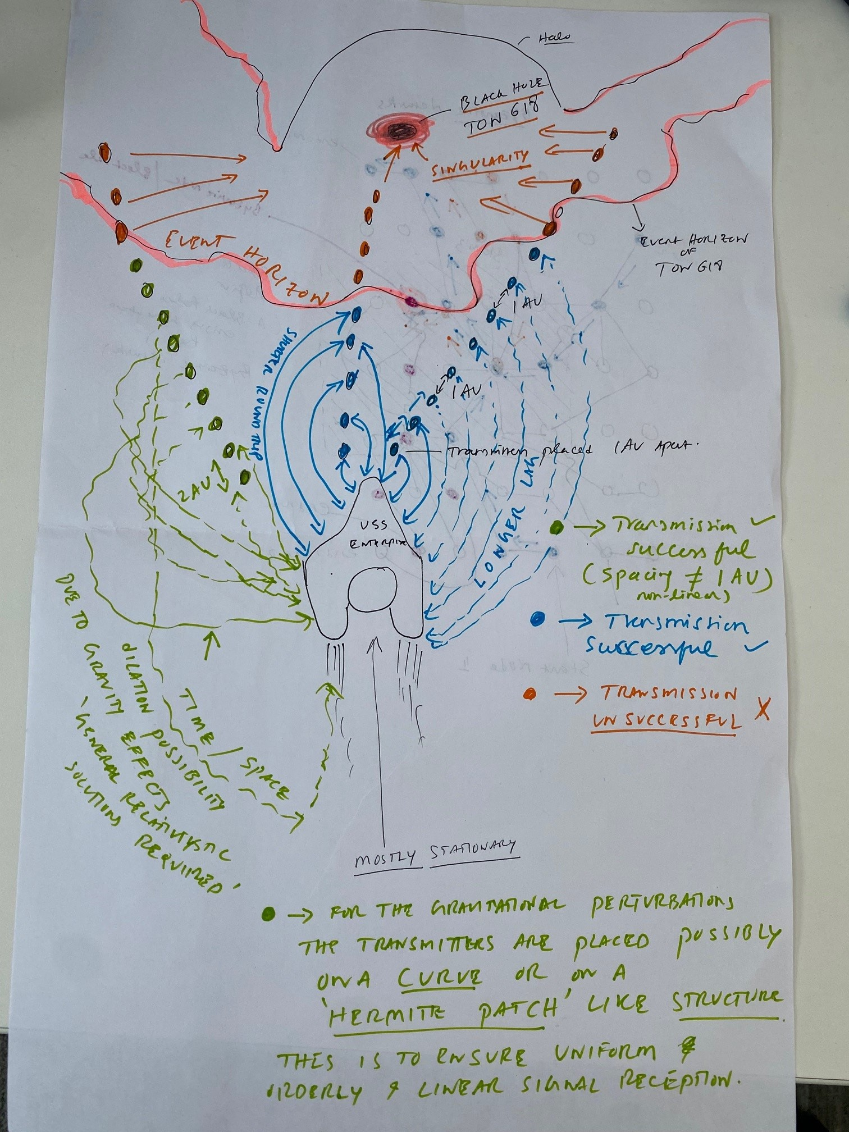
BH
This One, to be precise, throws Cosmic eggs ☺

Slide 15
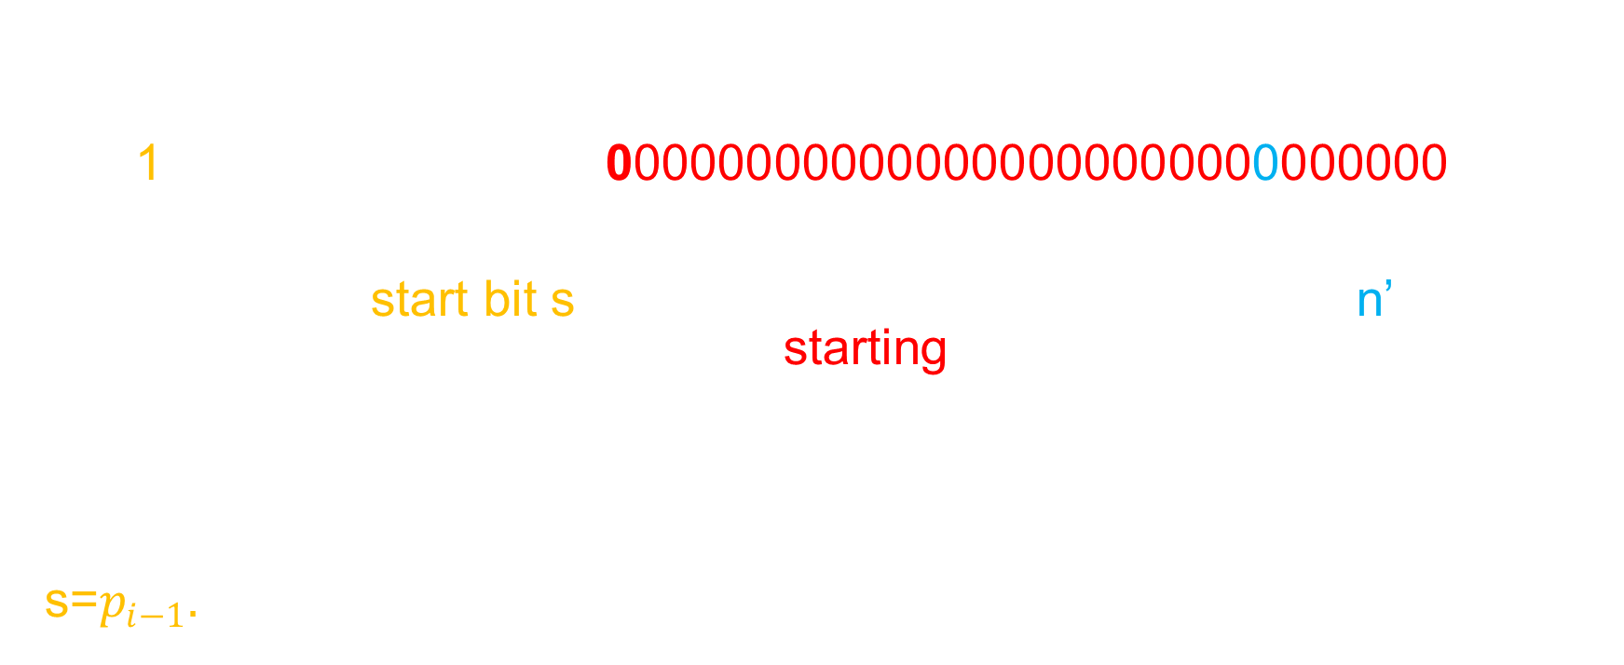
DataStream with infinite stream of 0s
……..000000……000000001..Caught it!

Slide 16
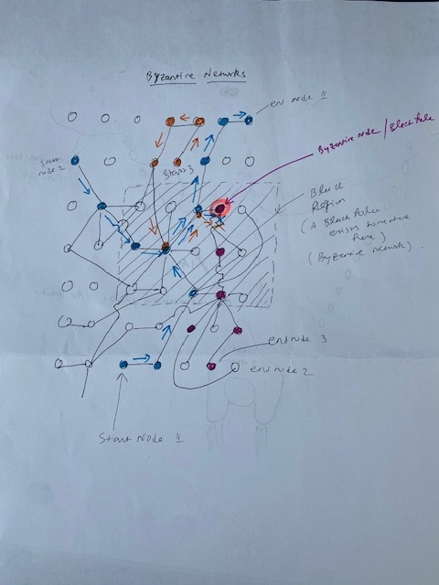
B
Oh. The Great Eater!

Slide 17
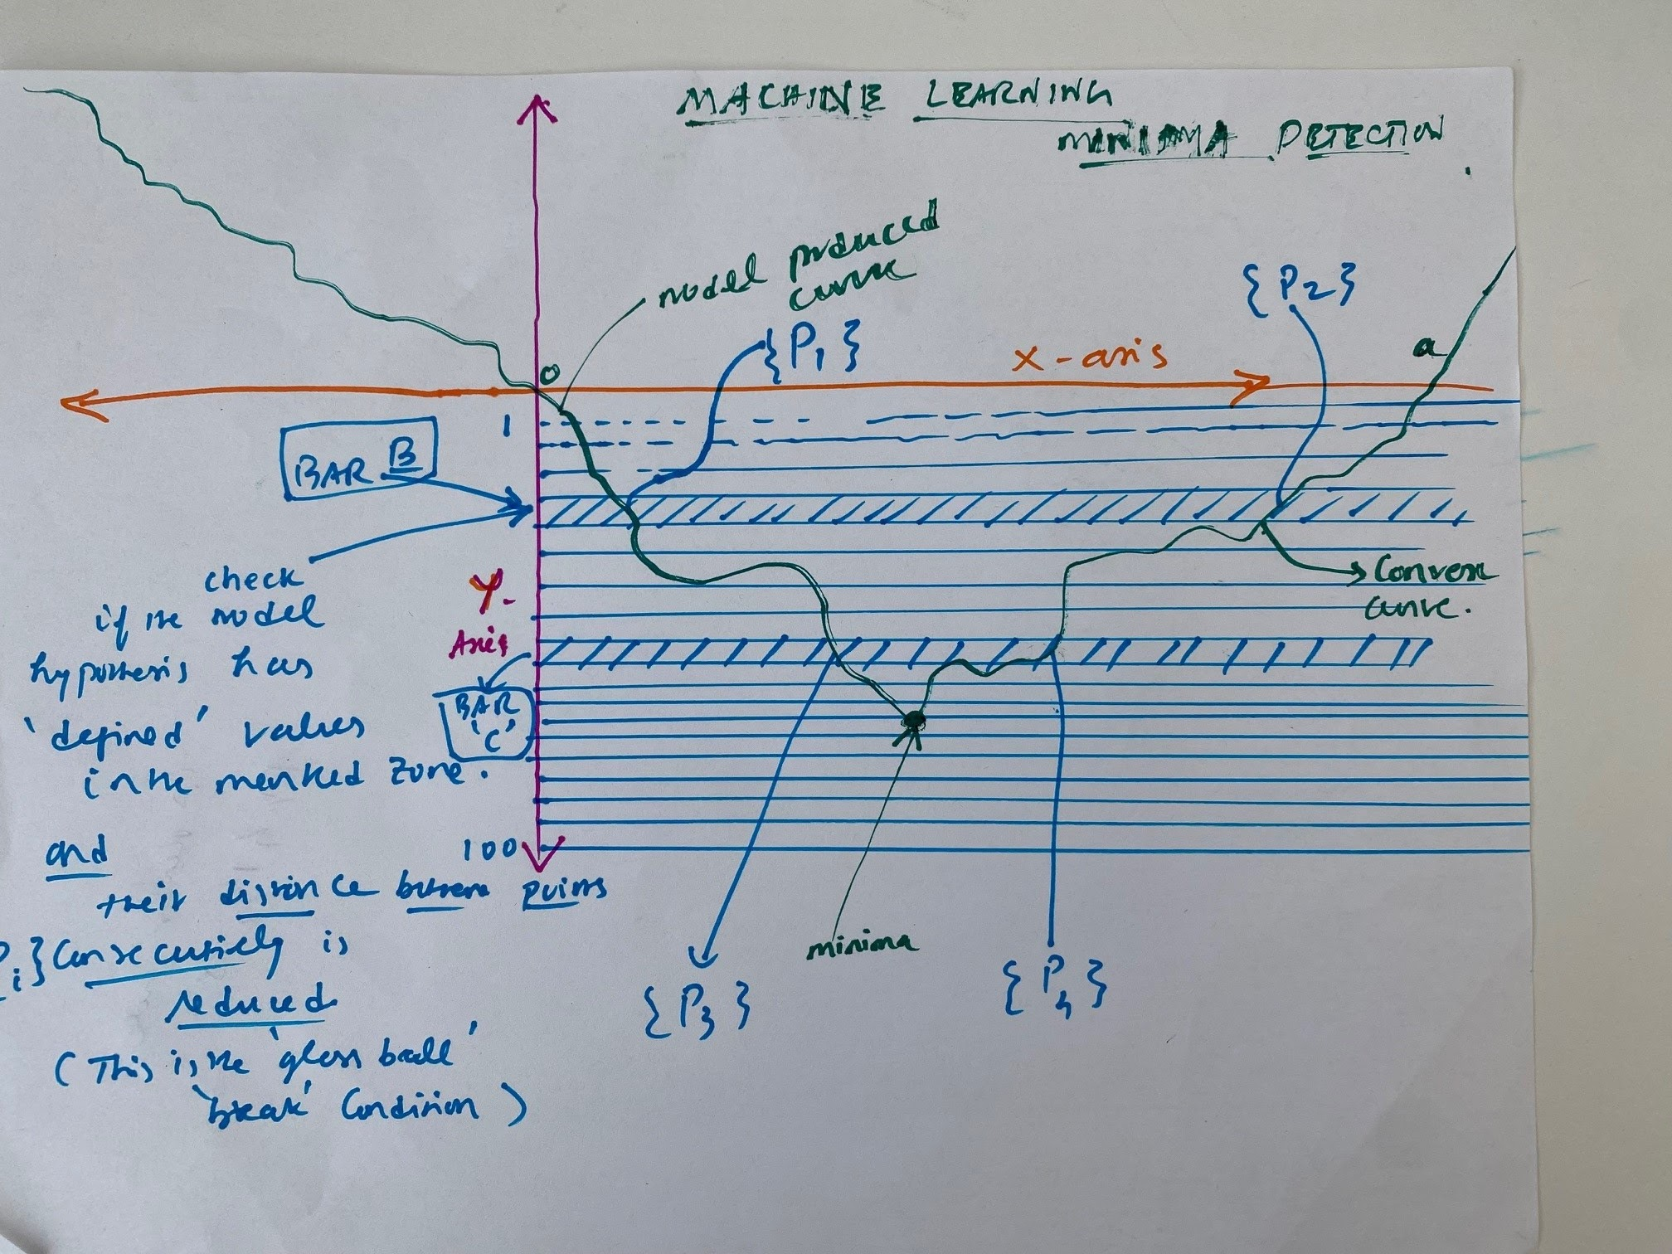
Learns to eat Machines ☺

Slide 18
Thank You!
Psst: I caught one you know, a bit shakily ! Bye now

